Slide 1
Bank Database Analysis & Power BI Dashboard
Prepared by Aya Mohab

Slide 2
DataSet overview
This database contains :
11 Main tables covering Account, ATM, Branch, Card, Customer, Customer Phones, Department, Employee, Loan, Transactions, Transactions_ATM_Account
1 Calculated Table [DateTable] to enable time-based filtering and make a Date Slicer
7 Calculated Columns Age Group, Customer Full Name, Month Start, Employee Full Name, Loan Status, Risk Rate, Term Label
20 Measures Active Accounts, Average Salary, Total High Risk Loans, etc

Slide 3
SQL Techniques Used
Aggregations : (Q1), (Q3), (Q4), (Q5), (Q6), (Q7), (Q8), (Q12), (Q14)
Joins : Left Join (Q2), Inner Join (Q4)(Q5)(Q7)(Q8)(Q9)(Q11)(Q13), Cross Join (Q6), Self Join (Q13), Multiple Joins (Q14)
CTEs : (Q6), (Q8), (Q9), (Q10), (Q11), (Q12), (Q13)
Window Functions : ROW_NUMBER() (Q9)(Q13), RANK() (Q4), LAG() (Q10)(Q11), LEAD() (Q11), NTILE() (Q12)
Filtering : Having (Q1), Time-based using DATEADD() (Q5)(Q7)

Slide 4
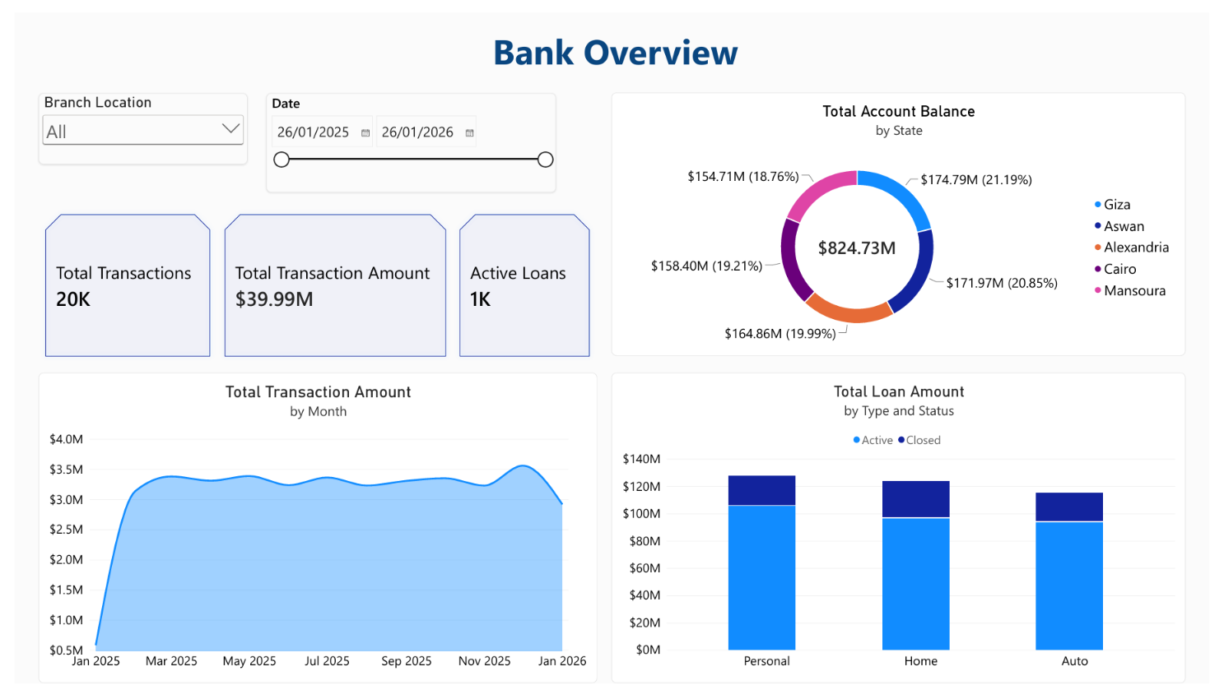

Slide 5
key Insights: Overview
The bank processed $39.99M in transactions across 20K transactions, showing steady, stable growth over the year.
Account balances are almost evenly distributed across all five states indicating a highly diversified customer base.
Across all loan types the majority is categorized as 'Active' rather than 'Closed' indicating strong, consistent repayment behavior and low risk on current lending.

Slide 6
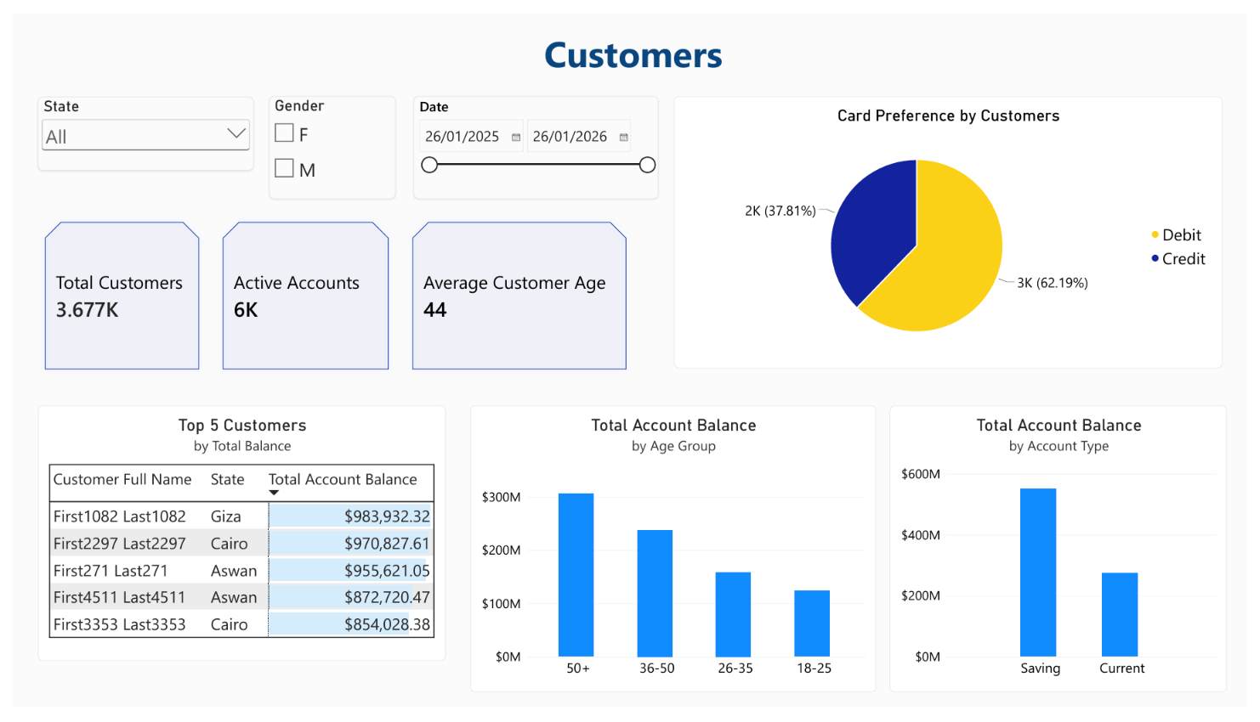

Slide 7
key Insights: Customers
The 50+ age group holds the largest share of wealth indicating a high-value client base.
Debit cards (62%) are preferred over Credit (38%) indicating conservative customers who prefer to spend existing funds rather than borrow.
Savings accounts hold almost double the total balance of Current accounts reinforcing the conservative customer profile.

Slide 8
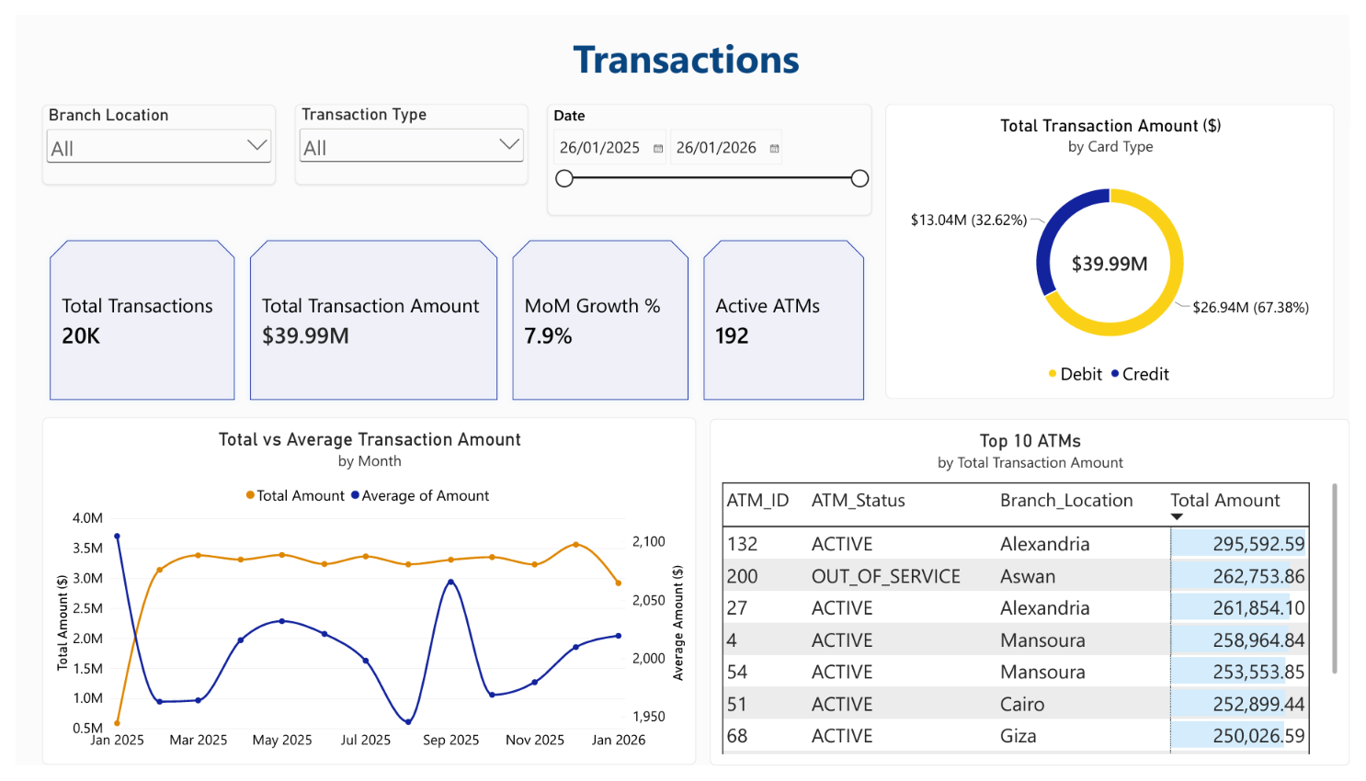

Slide 9
key Insights: transactions
Total Transaction amount is steady but the average amount spikes in September which means fewer transactions but with larger amounts are happening.
Month-over-Month Growth is 7.9%
ATM with ID 200 (Aswan) has the second highest total transaction amount but it is out of service (broken) that is a big red flag.
Debit cards dominate the transaction volume (67.38%) compared to Credit (32.62%) This perfectly aligns with the "conservative customer" profile and highlights an opportunity to upsell credit cards to increase fee revenue.

Slide 10
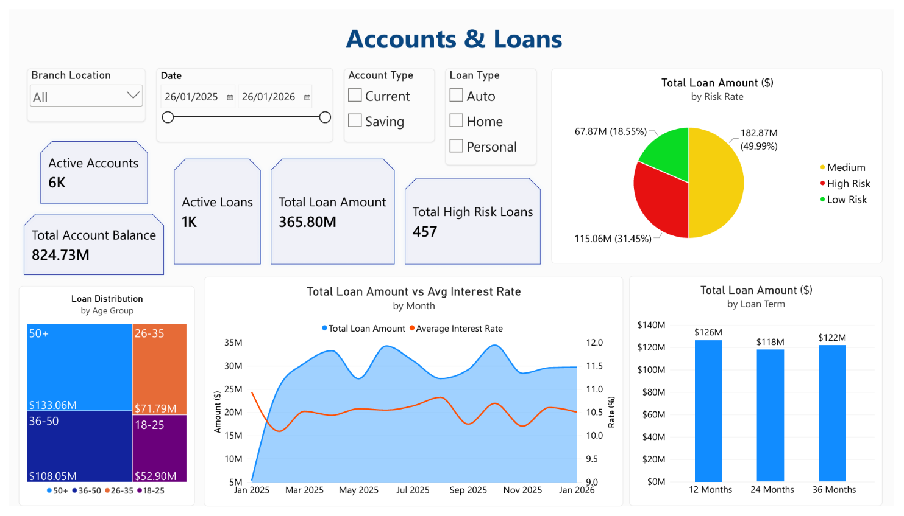

Slide 11
key Insights: accounts & Loans
Almost a third of the bank’s money ($115M) is currently sitting in High Risk lending which requires careful loan monitoring.
Loan amounts are evenly distributed across 12, 24, and 36-month terms.
The older generation is borrowing a lot, while the younger generation isn't borrowing much which shows that the older demographic is where the bank's lending profit comes from.

Slide 12
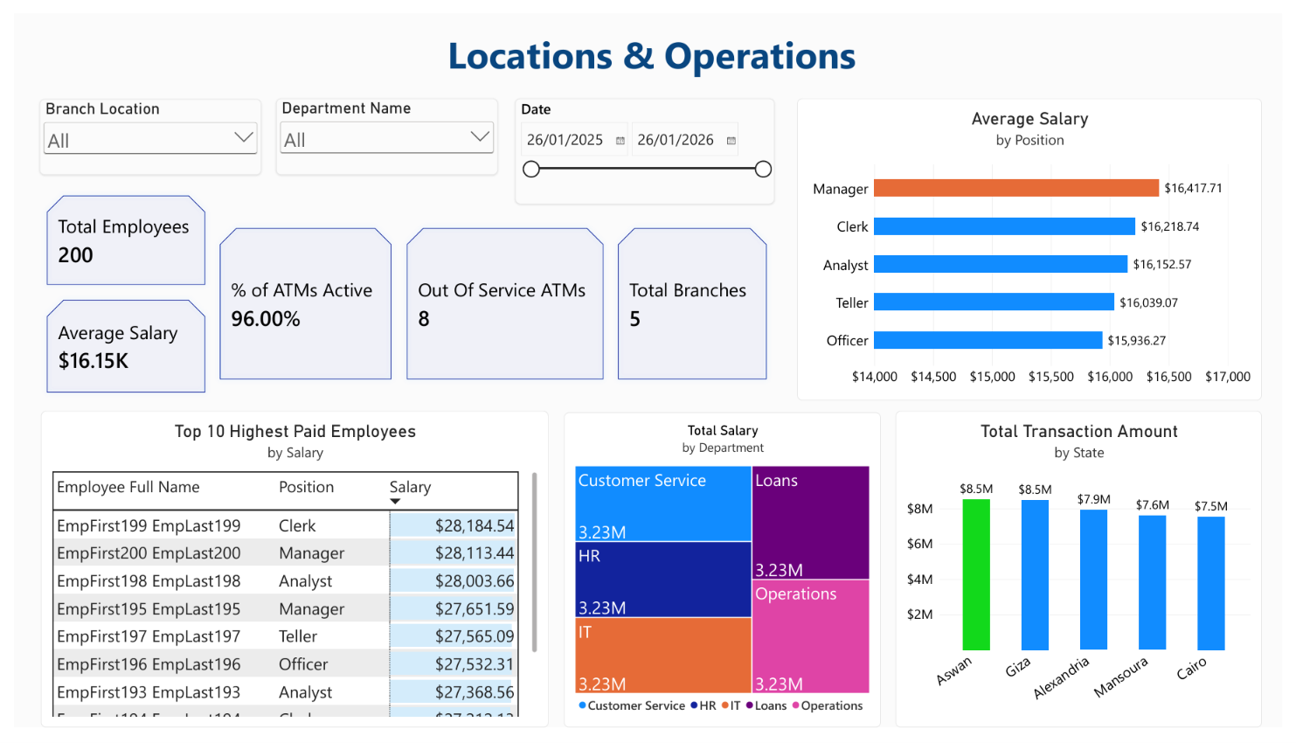

Slide 13
key Insights: Locations
& Operations
EmpFirst199 is a Clerk yet they are the highest paid employee in the entire bank ($28,184.54) they are out earning the Managers that is a massive red flag it suggests potential payroll fraud, favoritism, or a major flaw in the compensation structure.
The bank operates with 200 employees across 5 branches.
Managers earn the highest average salary ($16,417.71) followed by Clerks.
96% of ATMs are Active indicating highly reliable operational infrastructure.

Slide 14
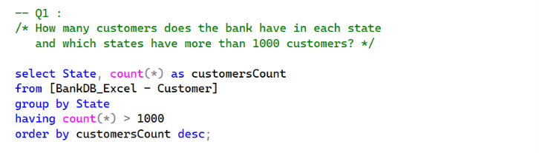
Customer Density by state
Business Value : It identifies which states have the highest customer density to guide local branch marketing and expansion strategies.

Slide 15
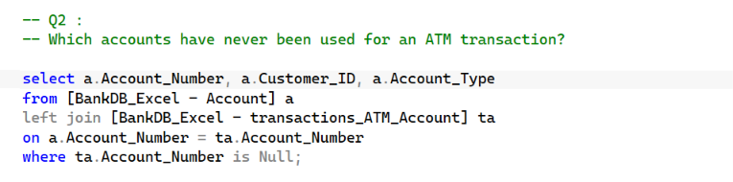
Identifying Dormant Accounts
Business Value : The bank can launch reactivation campaigns (offering free checking or ATM fee waivers) to bring them back to life.

Slide 16
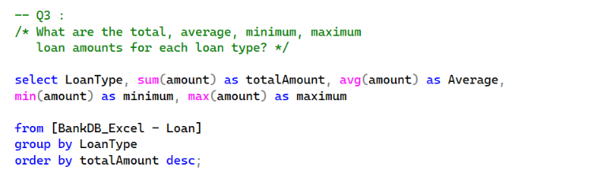
Loan Amount Analysis
Business Value : It identifies which loan type generates the largest revenue (Total Amount), the typical customer ticket size (Average), and the risk range of each product (Minimum vs. Maximum) to guide capital allocation and marketing strategies.

Slide 17
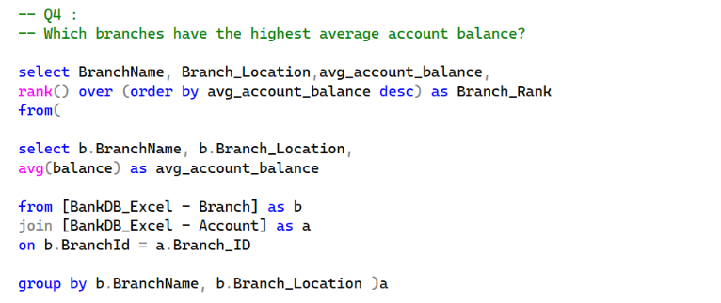
Top Branches by Customer Wealth
Business Value : Identifies which locations hold the wealthiest customers, allowing the bank to allocate top-tier advisory staff to those specific branches.

Slide 18
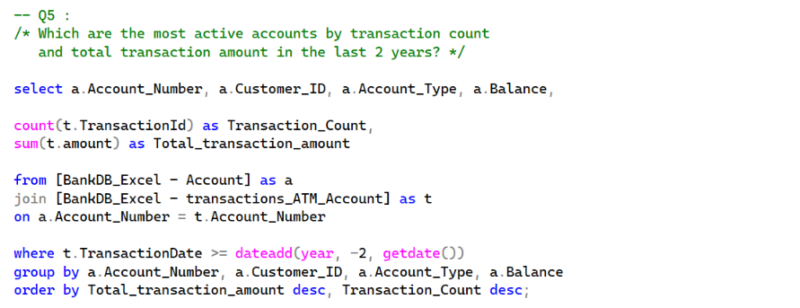
Identifying VIP Customers
Business Value : It pinpoints the most valuable accounts. These customers should receive premium service, waived fees and exclusive offers to ensure retention.

Slide 19
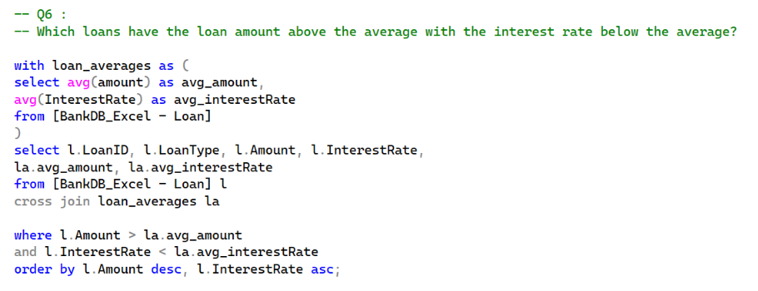
High Value Low Risk Loan Analysis
Business Value : It identifies the exact loans that make the bank the most money with the lowest risk of default. By isolating large-sum borrowers with low interest rates (prime clients), the bank can focus its retention and cross-selling strategies on those high-value, low-risk customers.

Slide 20
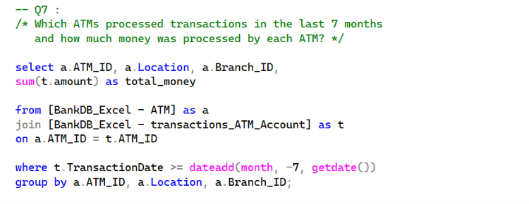
ATM Cash Flow Management
Business Value : It shows peak usage per machine, allowing the operations team to optimize cash refilling schedules and perform maintenance on the high-traffic machines to avoid breakdowns (like ATM 200 in Aswan).

Slide 21
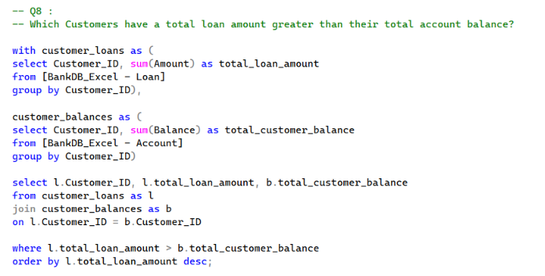
High-Risk Exposure Alert
Business Value : These customers are highly leveraged (owing more than they have saved) signaling a high potential for loan default. The team can proactively contact them to restructure their debt.

Slide 22
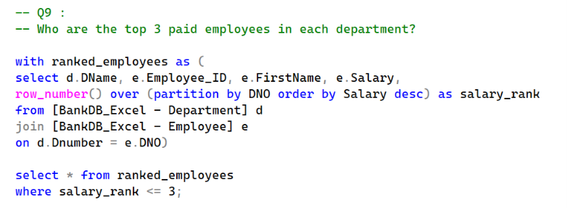
Talent Identification
Business Value : It reveals the senior experts in each department. HR can use this for succession planning and retention bonuses to prevent these vital employees from leaving.

Slide 23
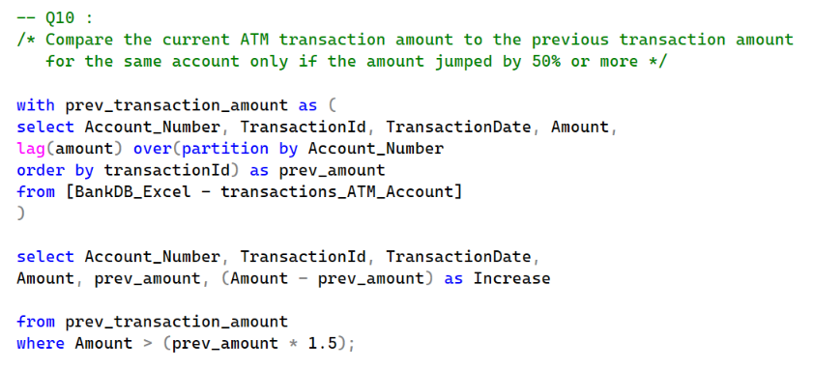
Detecting Potential Fraud
Business Value : A sudden 50% increase in transaction amount compared to the previous one is a classic red flag for stolen card usage, alerting the security team to freeze the account immediately.

Slide 24
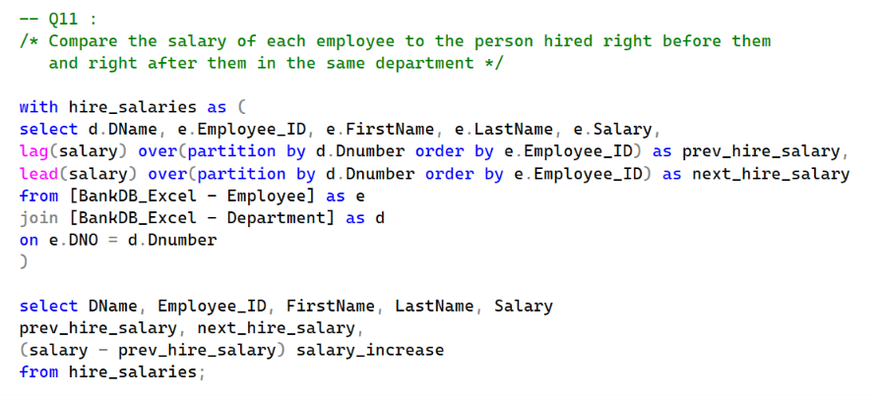
Pay Equity Analysis
Business Value : It compares a new hire's salary to the person hired right before them in the same department helping HR identify if they are overpaying new recruits or underpaying long-term staff.

Slide 25
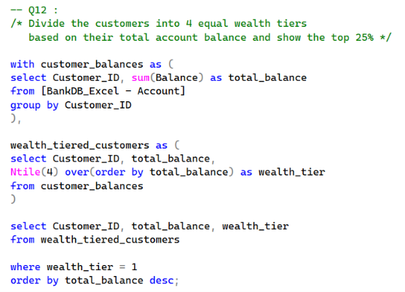
High-Net-Worth Segmentation
Business Value : It creates a clear hierarchy of customer wealth, allowing the bank to exclusively target the Top 25% tier with premium wealth management, investment advisory and luxury card products.

Slide 26
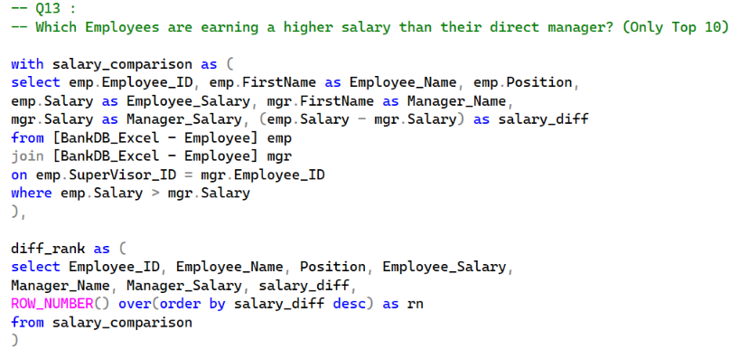
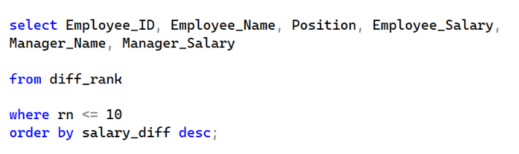
Compensation Structure Red Flag
Business Value : A Clerk or Analyst earning more than their Manager indicates a broken pay structure, demotivating senior staff and requiring immediate HR correction.

Slide 27
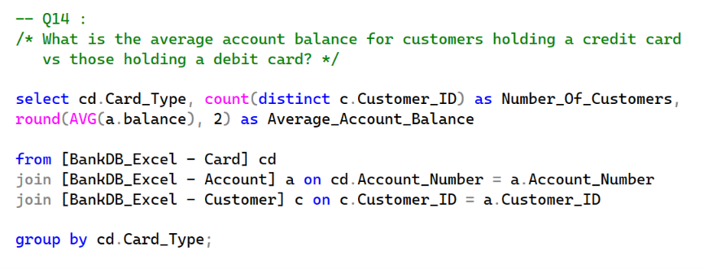
Cross-Selling Upsell
Business Value : It identifies the wealth profile of different customer segments to uncover a big Cross-Selling opportunity.

Slide 28
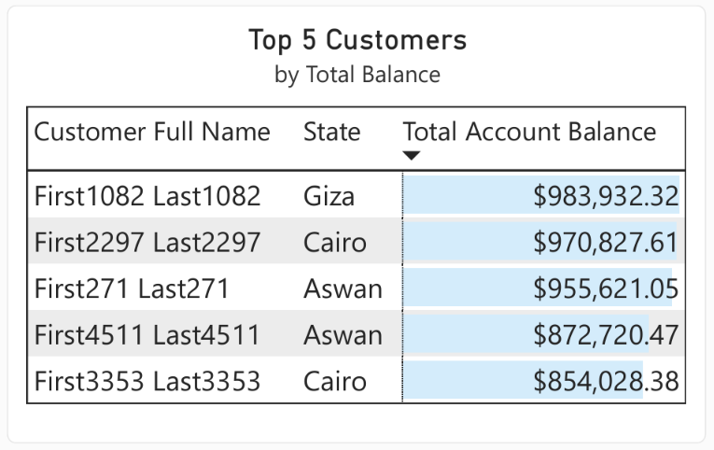
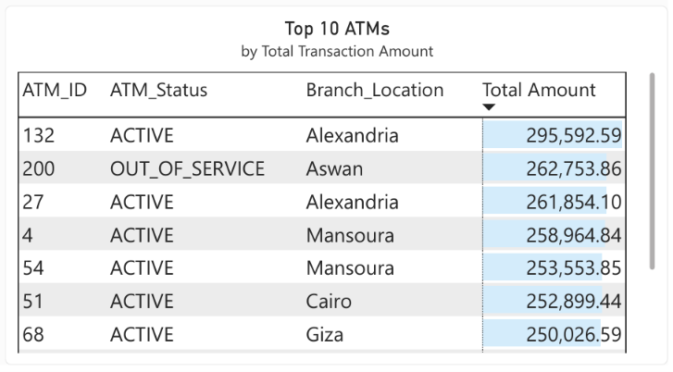
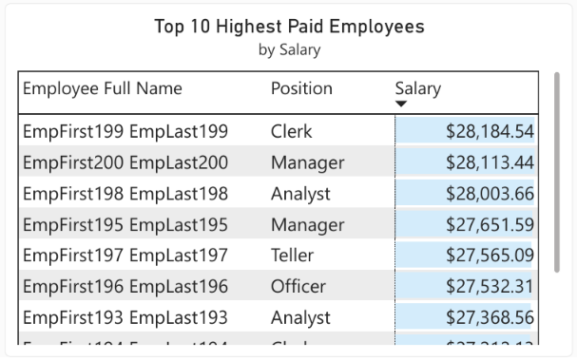
Business Questions & Answers
What are the top-performing entities?
SQL ANSWER : (Q4), (Q5), (Q9), (Q12)
DASHBOARD VISUAL(S) ANSWER :

Slide 29
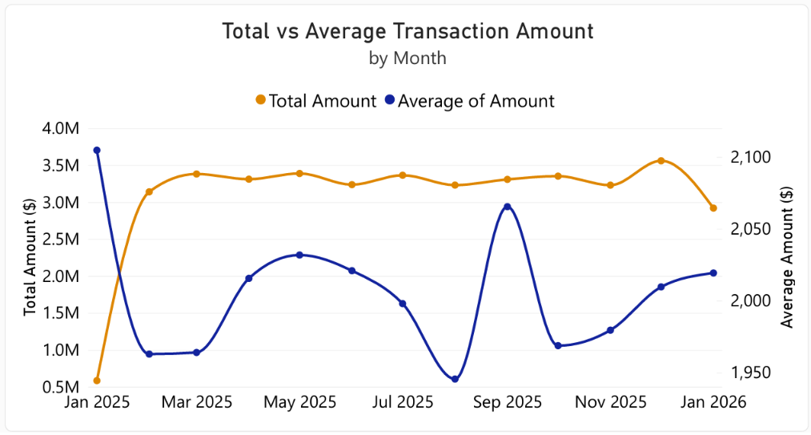
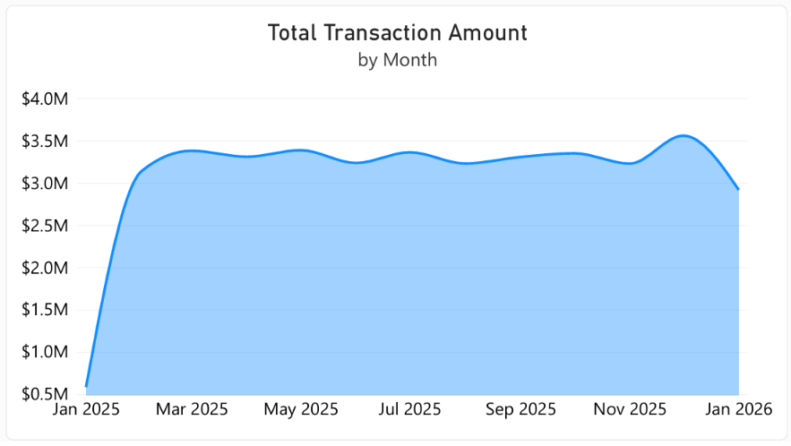
Business Questions & Answers
How does performance change over time?
SQL ANSWER : (Q5), (Q7)
DASHBOARD VISUAL(S) ANSWER :

Slide 30
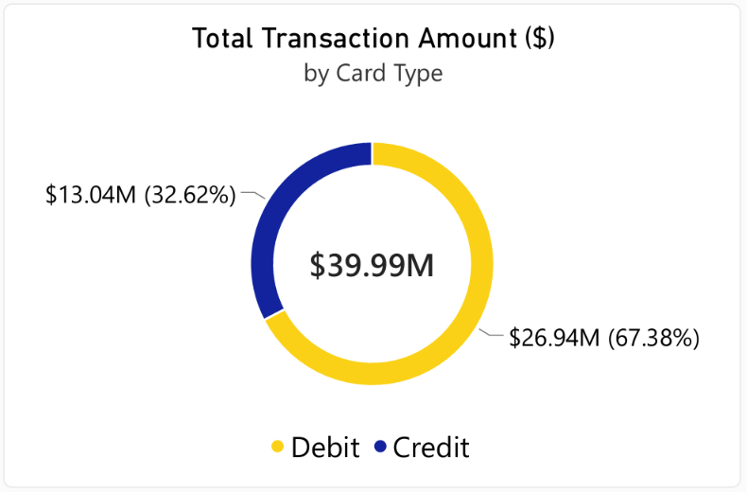
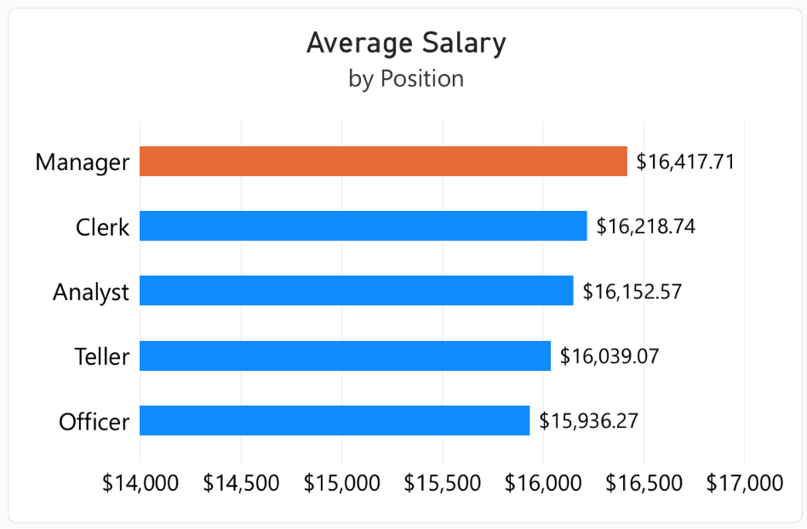
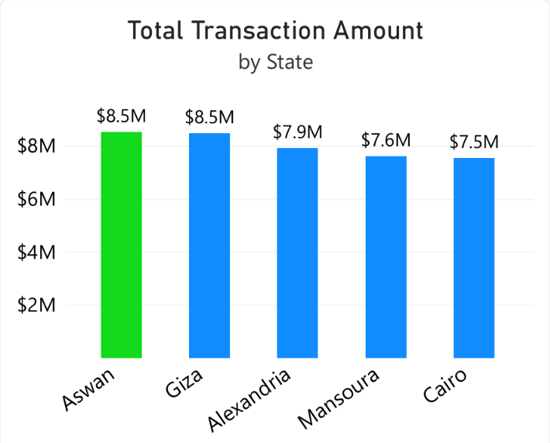
Business Questions & Answers
Which categories/locations/customers generate the highest value?
SQL ANSWER : (Q1), (Q4), (Q7), (Q14)
DASHBOARD VISUAL(S) ANSWER :

Slide 31
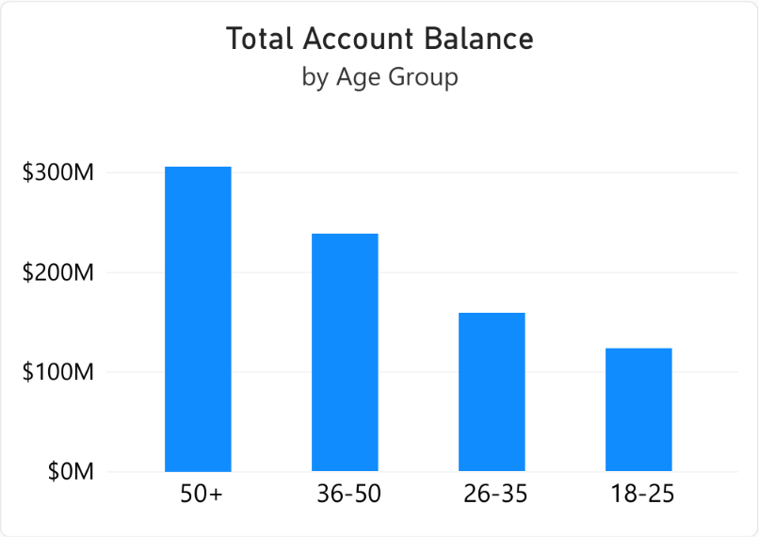
Business Questions & Answers
Are there noticeable trends or patterns?
SQL ANSWER : (Q10), (Q11)
DASHBOARD VISUAL(S) ANSWER :

Slide 32
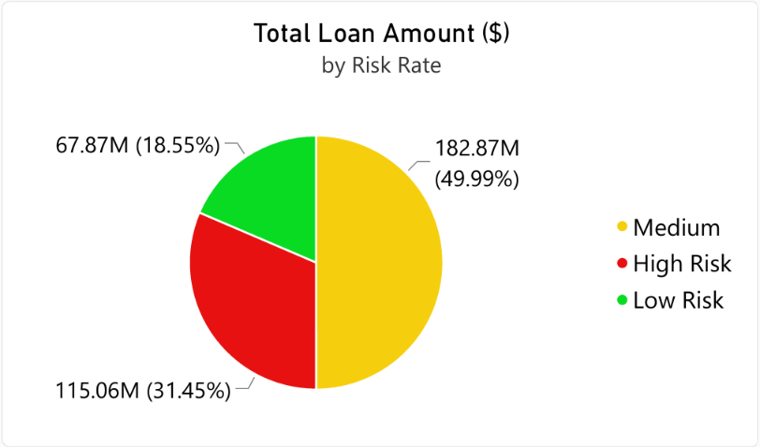
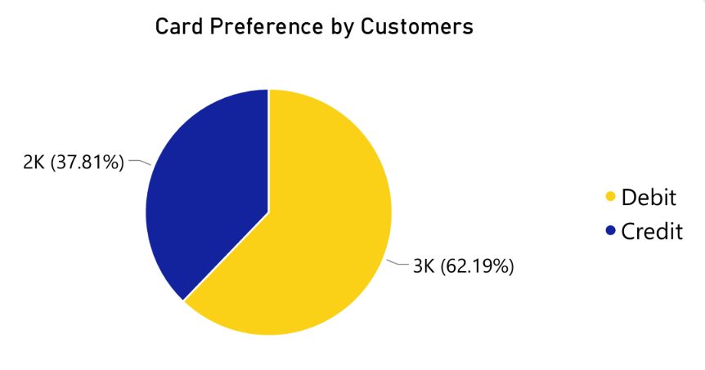
Business Questions & Answers
What recommendations can be made?
SQL ANSWER : (Q2), (Q8), (Q14)
DASHBOARD VISUAL(S) ANSWER :

Slide 33
Final recommendations
Urgent Maintenance for ATM ID 200 since it is the second highest performer ($262k).
Target the 50+ age group with retirement and wealth management products since they hold the majority of the $824M in balances.
The bank should Implement stricter credit score requirements and income verification for loans that fall into the High Risk category.
The bank should target their high-balance Debit card users to upsell them a Credit card to increase fee revenue.
Audit the broken compensation structure, as a Clerk is currently the highest paid employee out-earning all Managers.

Slide 34
THANK YOU

